Slide 1
PVHS/SJRSC Dual Enrollment
Lunch and Learn

Slide 2
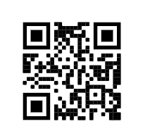
St. Johns River State College DE
Dual Enrollment at SJRC allows you to take college courses, for FREE, while you are attending high school.
DE Courses are weighted on a 5.0 scale, like AP courses, without the AP Exam.
DE Courses at SJRSC are transferrable to any Florida Public college or university, and most credits will transfer to out of state schools also.

Slide 3
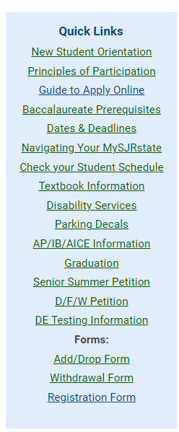
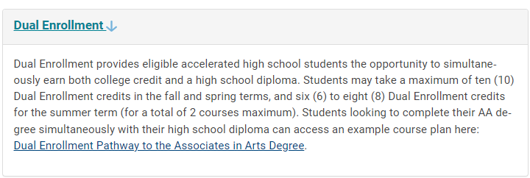
SJR DE Website helpful info

Slide 4
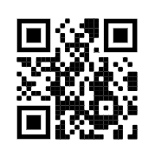
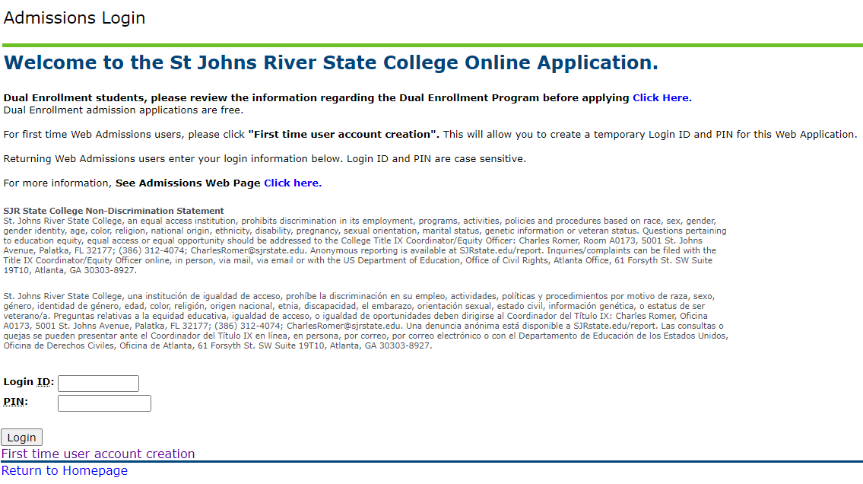
SJR DE step-by-step enrollment
1. Complete the ONLINE Application at bit.ly/2APhdpC
Obtain your X number, write it down!
If this is your first time taking DE, click First time user account creation!

Slide 5
SJR DE step-by-step enrollment
2. Complete the SJRSC Consent form for Participation in the DE Program.
Fill out completely, with X number and parent/guardian signature
Spring 2023

Slide 6
SJR DE step-by-step enrollment
3. Obtain your test scores. Acceptable scores include SAT, ACT, PSAT, or PERT scores
Need official score report, not a screen shot!
Reach out to Ms. Healey via Schoology if you need to take a PERT exam.

Slide 7
SJR DE step-by-step enrollment
4. Turn in your Consent form AND official test scores to your School Counselor.
Your School Counselor WILL NOT take your consent form if you do not have test scores printed and attached.
Consent form and test scores due by Friday Nov 18. NO late forms accepted.

Slide 8
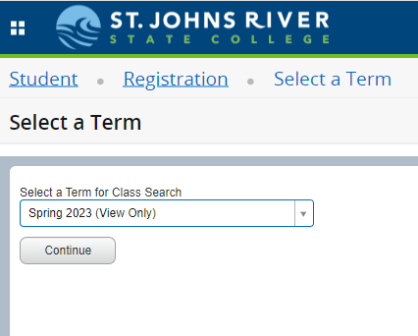
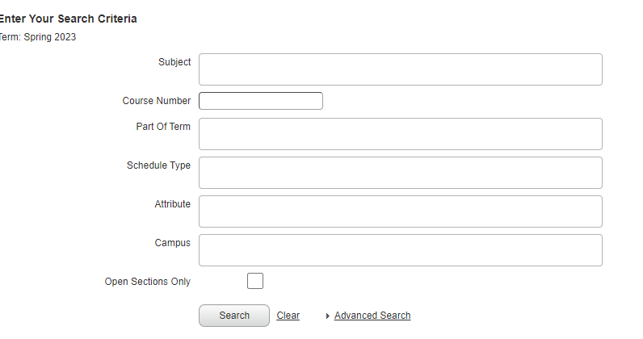
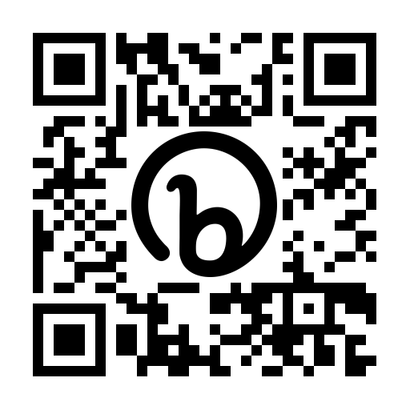
SJR DE step-by-step enrollment
5. Complete the SJR Enrollment form by filling out exactly what courses you want to sign up for. You must also list at least 2 alternates for your courses in case the ones you want are full.
SJR Course Catalog: https://bit.ly/3BMKU8X
SJR Course Catalog:

Slide 9
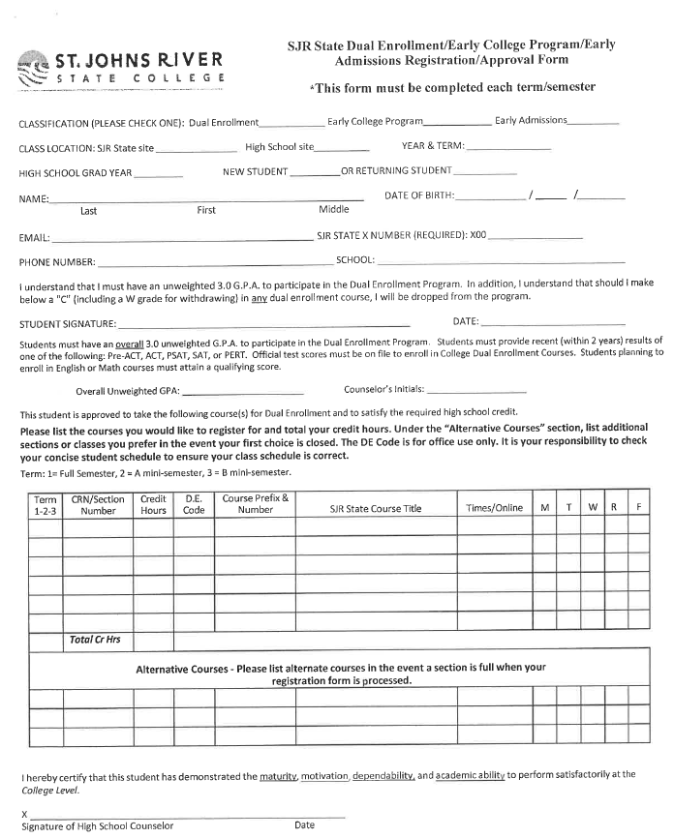
Check DE
Location – SJR State Site – or write ONLINE
Complete your Grad Year and check if you are a new or returning
Fill in name and date of birth
Personal email and SJR X number
Personal phone number and School = Ponte Vedra HS
SIGN and DATE!
Get your Unweighted GPA from HAC
NEXT – Log into the SRJSC Course Catalog for this box
Find a class you want to take and fill in the correct information for this box. Make sure you write down the CORRECT CRN number, CORRECT Course number and CORRECT Title.
***MAKE SURE you choose an online CRN option if you do not want to go to a campus site!
Fill out at least 2 alternate courses. These can be the same course but with different CRN Numbers!!

Slide 10
SJR DE step-by-step enrollment
6. Turn in your Registration form to your School Counselor.
Your School Counselor WILL NOT take your registration form if you do not have 2 alternate courses
Registration form is due to your School Counselor by
Monday November 28. NO LATE FORMS ACCEPTED.

Slide 11
Spring 2023
DO NOT pick a section that is FULL or close to full. You will NOT get in!
Fall 2022

Slide 12
FAQ’s
What is my DE Eligibility at SJR? - You can take DE classes for 3 years in HS.
How many hours can I take in 1 semester? – Fall and Spring semester 10 DE credit hours, Summer you can take 2 classes total, regardless of credit hours.
Who do I reach out to if I have a problem? - If you have questions/problems during the enrollment process, see Ashlee Henderson (registrar) or your School Counselor. Once you are enrolled, all questions/problems must go through the SJRSC DE program.
What if I sign up and want to drop? - If you are in the Add/Drop window you can drop with no penalty. After the add/drop window you will get a WITHDRAW on both your SJRSC and PVHS transcripts.

