Slide 1


Using Your PSAT/NMSQT® Scores
to Increase College Readiness

Slide 2

Get to Know the PSAT/NMSQT®
The PSAT/NMSQT® is highly relevant to your future success because it focuses on the skills and knowledge at the heart of education.
It measures:
  What you learn in high school
  What you need to succeed in college
The PSAT/NMSQT measures reading, writing and language, and math skills developed over many years, both in and out of school.
The PSAT/NMSQT does not ask for facts from literature, history, or science, or recall of math formulas, because it measures your reasoning and critical thinking skills.
You don’t have to discover secret tricks or cram the night before.
There is no penalty for guessing.
The test length is 2 hours, 45 minutes
2

Slide 3

What are the Benefits of Taking the PSAT/NMSQT®?
Prepare for the new SAT®,
coming in March 2016
Get free, personalized, and focused practice through Khan Academy®
Start getting ready for college with college and career planning tools
Enter the National Merit® Scholarship Program
See which AP® courses you might be ready for
Get admission and financial aid information from colleges

Slide 4

How Do I Access My PSAT/NMSQT® Scores and Reports?
Review your Online reports
Review Your Paper Score Report
4

Slide 5
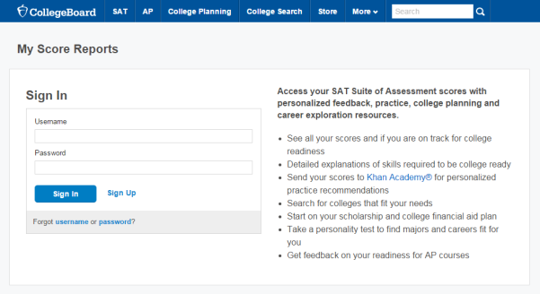
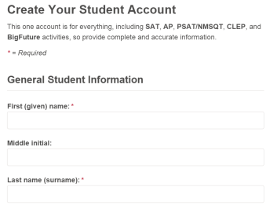
How Do I Access My Online PSAT/NMSQT® Scores and Reports?
  Log in to an existing College Board account or create a new one at studentscores.collegeboard.org
5

Slide 6

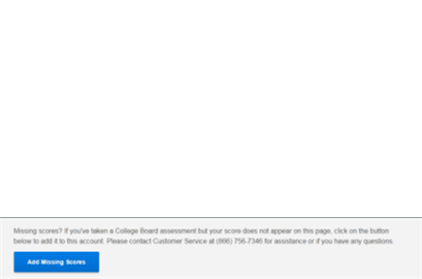
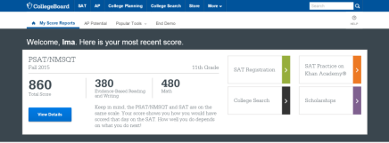
How Do I Access My Online PSAT/NMSQT® Scores and Reports? (cont.)
1. Log in to Your Account
2. Select PSAT/NMSQT Scores
*Or*
3. Use “Missing Scores”
to locate scores
6

Slide 7

What Will I Learn About My Scores?
7

Slide 8
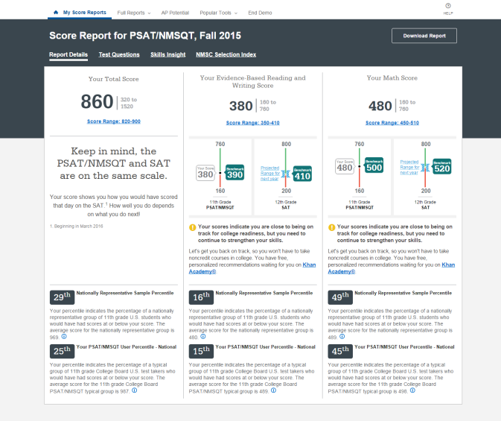
How Do I See My Detailed Scores?
8

Slide 9
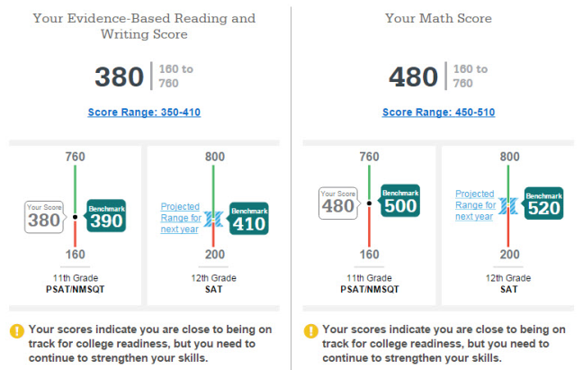
How Will I Do on the SAT®?
9

Slide 10
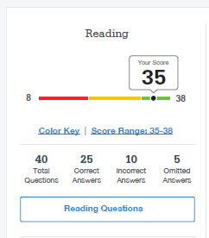
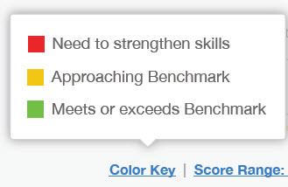
How Did My Score Measure Against College Readiness Benchmarks?
Section, test, and subscores all report scores in performance zones which indicate whether you are on track for success in the first year of college.
For section scores
  Need to Strengthen Skills = below grade-level benchmark by more than one year
  Approaching Benchmark = below grade-level benchmark by one year or less
  Meets or exceeds Benchmark = at or above grade-level benchmark
For test scores and subscores,
  Red, yellow, and green ranges reflect areas of strengths and weaknesses compared to the typical performance of students
10

Slide 11
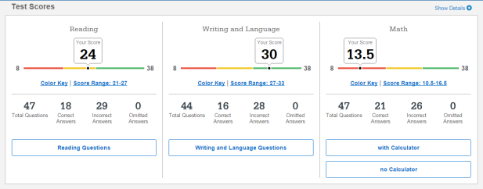
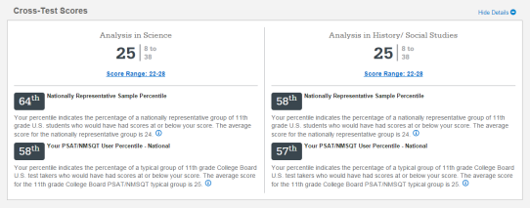
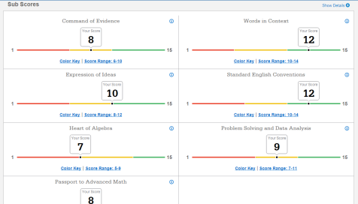
What Do My Scores Tell Me?
11

Slide 12
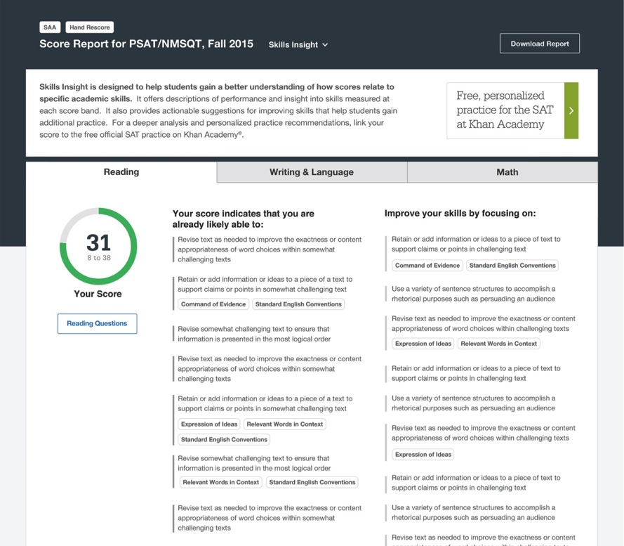
How Can I Improve My Academic Skills?
12

Slide 13
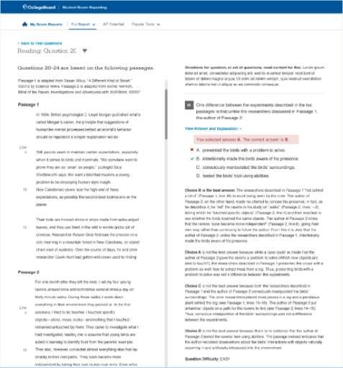
What Can I Learn From My Answers?
Look at my online score report
  Identify the questions I answered incorrectly
  Find the correct answer and read the answer explanation
  Explain why the error was made
  Ask questions about answer explanations that are not clear
13

Slide 14
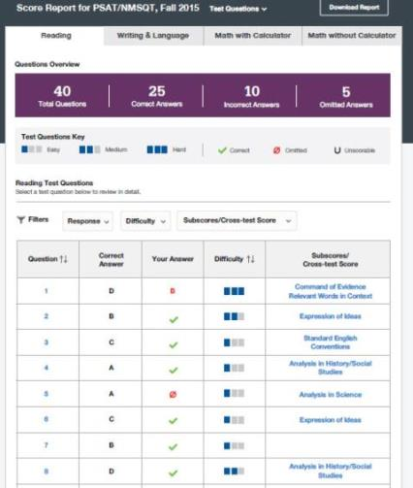
What Can I Learn From My Answers? (cont.)
Look at the types of questions I answered incorrectly and skipped:
  Identify the level of difficulty. How many questions did I miss at each level?
  Was I more likely to skip questions associated with any subscore or cross-test score?
  What inferences can I make about areas for improvement based on the types of questions I missed and skipped?
14

Slide 15
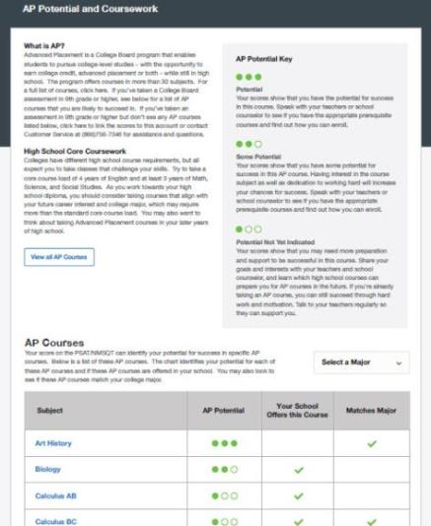
What is My AP Potential™?
College Board research shows that students who score a 3 or higher on an AP Exam typically experience greater academic success in college and are more likely to earn a college degree on time than non-AP students.
AP Potential™ uses scores from the PSAT/NMSQT to provide predictions for 21 AP Exams.
15

Slide 16
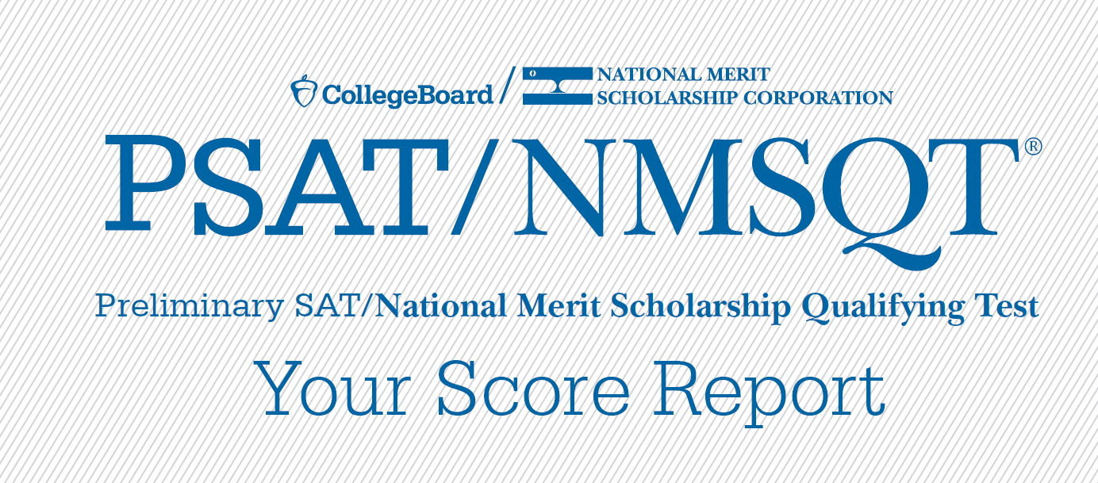
Understanding My Paper Score Report
16

Slide 17
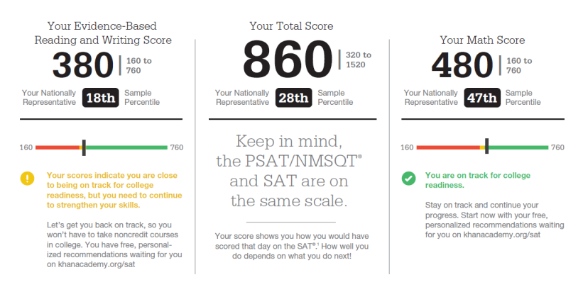
What Are My Scores?
17

Slide 18
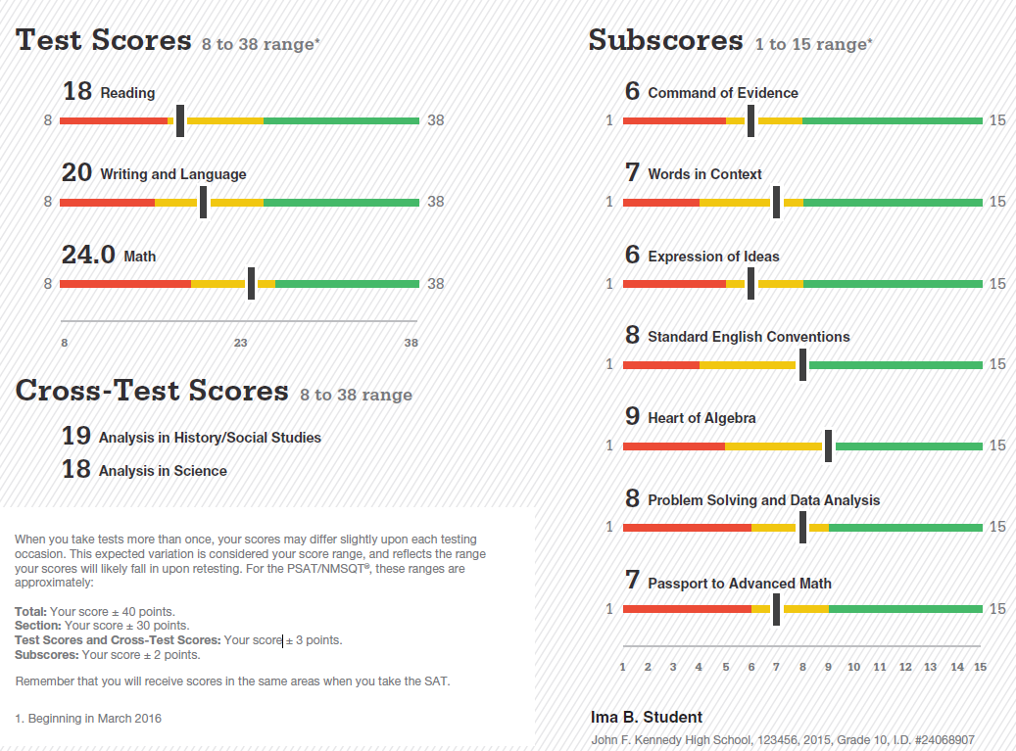
What Are My Scores? (cont.)
18

Slide 19
What Are My Score Percentiles?
19

Slide 20
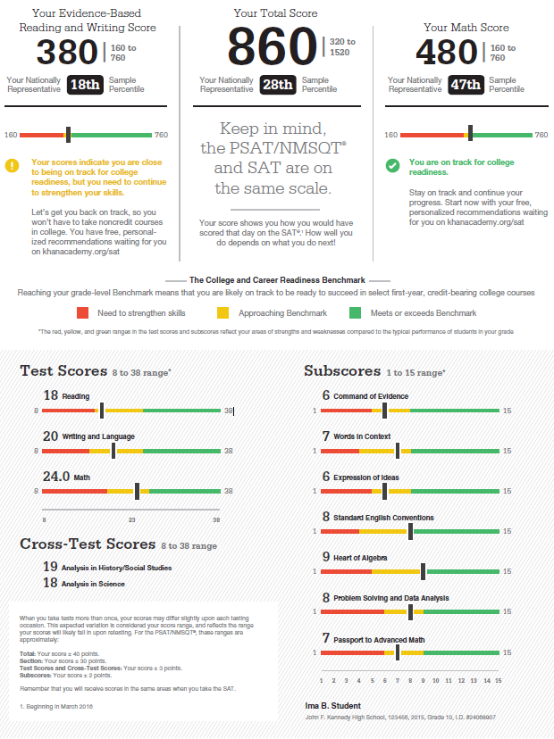
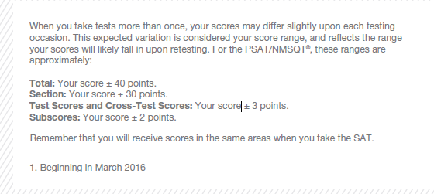
What Are My Score Ranges?
20

Slide 21
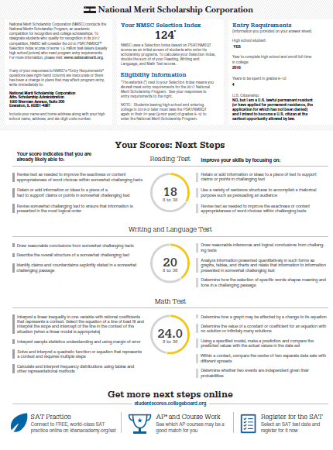
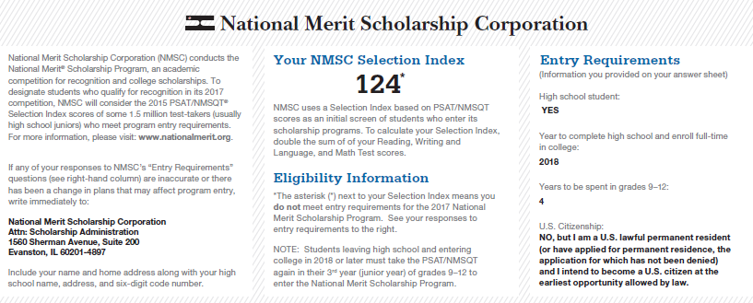
What is the National Merit® Scholarship Program?
21

Slide 22
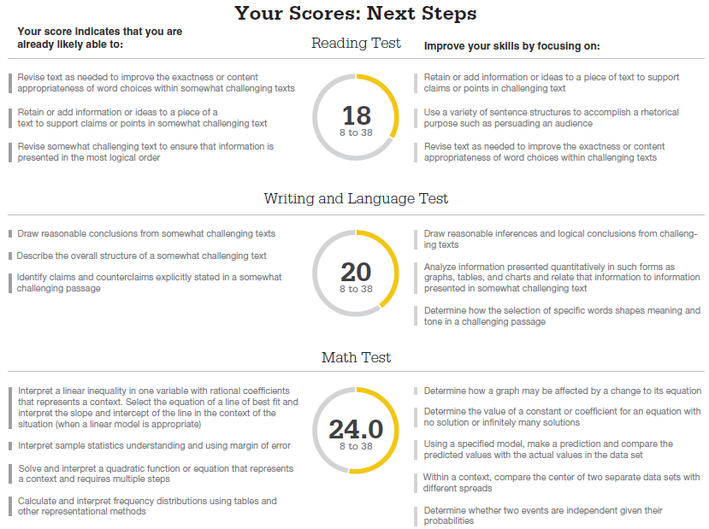
What Are My Areas of Strength?
What Skills Do I Need to Build?
22

Slide 23

What Are My Next Steps?
Continue to take challenging courses in high school
Link scores with Khan Academy
Set up a practice plan and stick to it
Register for the SAT
Utilize other resources to research and prepare for college
23

Slide 24

Official SAT Practice with Khan Academy® – It’s FREE!
Sign up for Official SAT Practice for free
  satpractice.org
Complete practice problems and diagnostic quizzes
Link your College Board and Khan Academy accounts.
  All SAT Suite results will be sent to further customize practice on Khan Academy using actual results.
24

Slide 25


How Can I Practice with Khan Academy®?
Saul Khan explains Official SAT Practice on Khan Academy

Slide 26

What steps will I follow to link my College Board account to Khan Academy®?
Step 1: Log in or create a Khan Academy Account
Step 2: When prompted; agree to link your Khan Academy and College Board account. You will then be directed to collegeboard.org.
Step 3: Sign in or create a
College Board Account
Step 4: When prompted; hit “Send” to authorize the account linking
Step 5: Start practicing on Official SAT practice on Khan Academy!
26

Slide 27
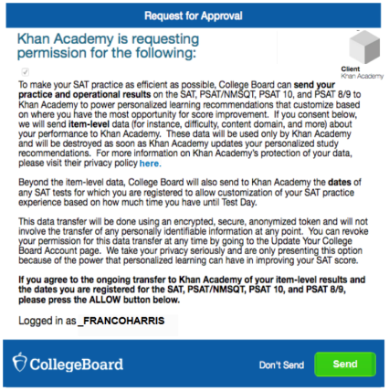
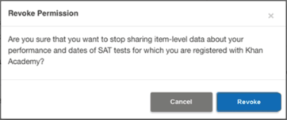
How can I Link my College Board and
Khan Academy® Accounts?
After successfully logging in to your College Board account, you will be asked to authorize the account linking.
After clicking “Send,” you will be redirected to SAT practice on the Khan Academy site.
You can remove the link at any time, by clicking on “Revoke” which is found in College Board account settings.
27

Slide 28

When Should I Take the SAT®?
Most students take the SAT in the spring of their junior year.
The last administration of the current SAT: January 23, 2016.
The first administration of the new SAT is March 5, 2016.
Many students choose to take the SAT more than one time. Additional SAT dates include:
  May 7, 2016 (scores from the March 5 administration will not be available prior to this test date)
  June 4, 2016
28

Slide 29
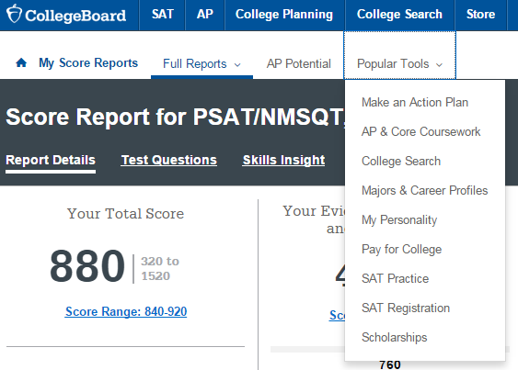
How Do I Register for the SAT®?
SAT Registration link from Popular Tools menu or
www.sat.org/register
29

Slide 30
What Additional Resources Will Help Me Prepare for My Future?
BigFuture™
  College Action Plan
  College Search
  Scholarships
  Financial Aid
MyRoad™ Personality explorer
Student Search Service®
30

Slide 31
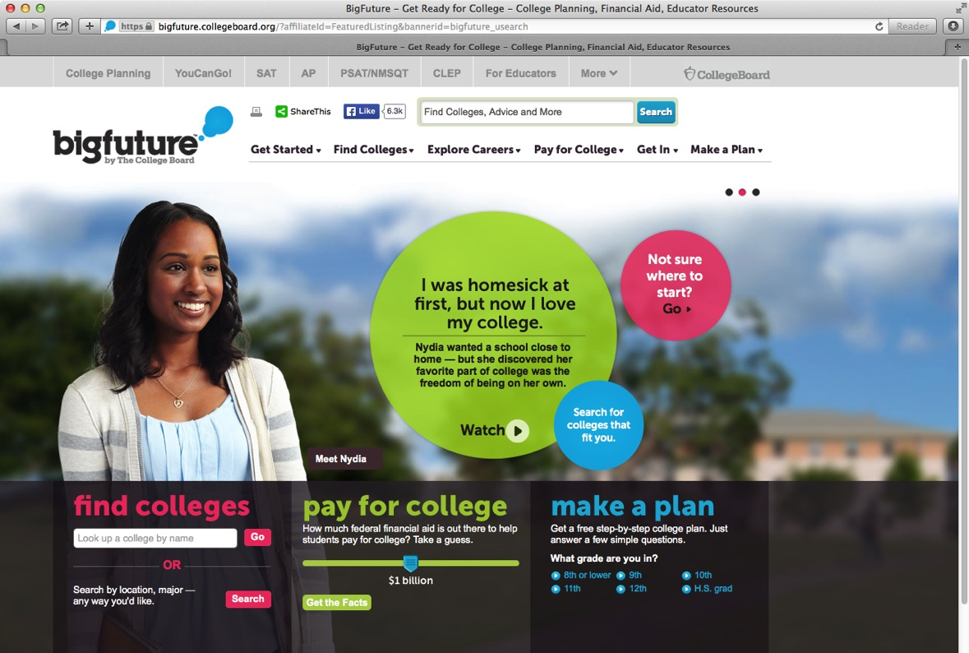
BigFuture™ – Search Colleges, Scholarships, and Careers
31

Slide 32
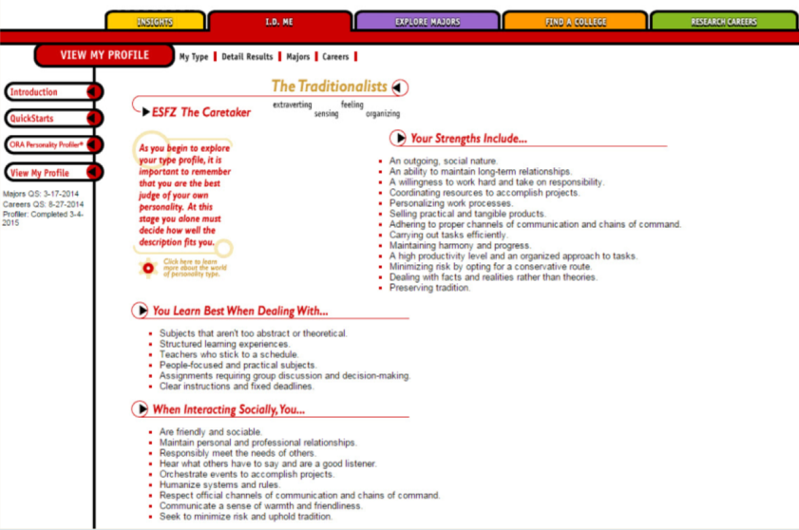
MyRoad™ Personality Explorer
32
Notes:
Once students are logged in, they are taken to their My Plan page. In My Plan, students can develop their own portfolios and resumes.
They can assemble information they' will need for college applications, brainstorm ideas for application essays, and record their interests and accomplishments for both college and career planning.

Slide 33
Student Search Service®
Participate voluntarily
Connect with more than 1,200 colleges, universities, scholarship programs, and educational organizations
Sign up when you take the test:
  Choose to participate in Student Search Service when registering for a College Board test (fill in the circle on the answer sheet).
  Provide information about yourself on your answer sheet.
  Participating organizations can then search for groups of students who may be a good fit.
  FYI: The College Board never shares information on disabilities, parental education, self-reported parental income, Social Security numbers, phone numbers, or actual test scores through Student Search Service.
33

