Slide 1
Linking Khan Academy and College Board
Student Accounts

Slide 2
Why link Khan Academy and
College Board Accounts?
You will be able to link your College Board and Khan Academy accounts in
early January 2016 when you get your PSAT/NMSQT results.
Linking your accounts will further personalize your practice: the practice recommendations on Khan Academy will be based on your PSAT/NMSQT results
All future scores from the SAT, PSAT/NMSQT, PSAT 10 and PSAT 8/9
will also be sent to help customize your practice and recommendations on
Khan Academy.
You will be able to jump right into practice without having to take any additional diagnostic quizzes or practice tests to get personalized recommendations.
Please note that you can terminate your account linking at any time.

Slide 3
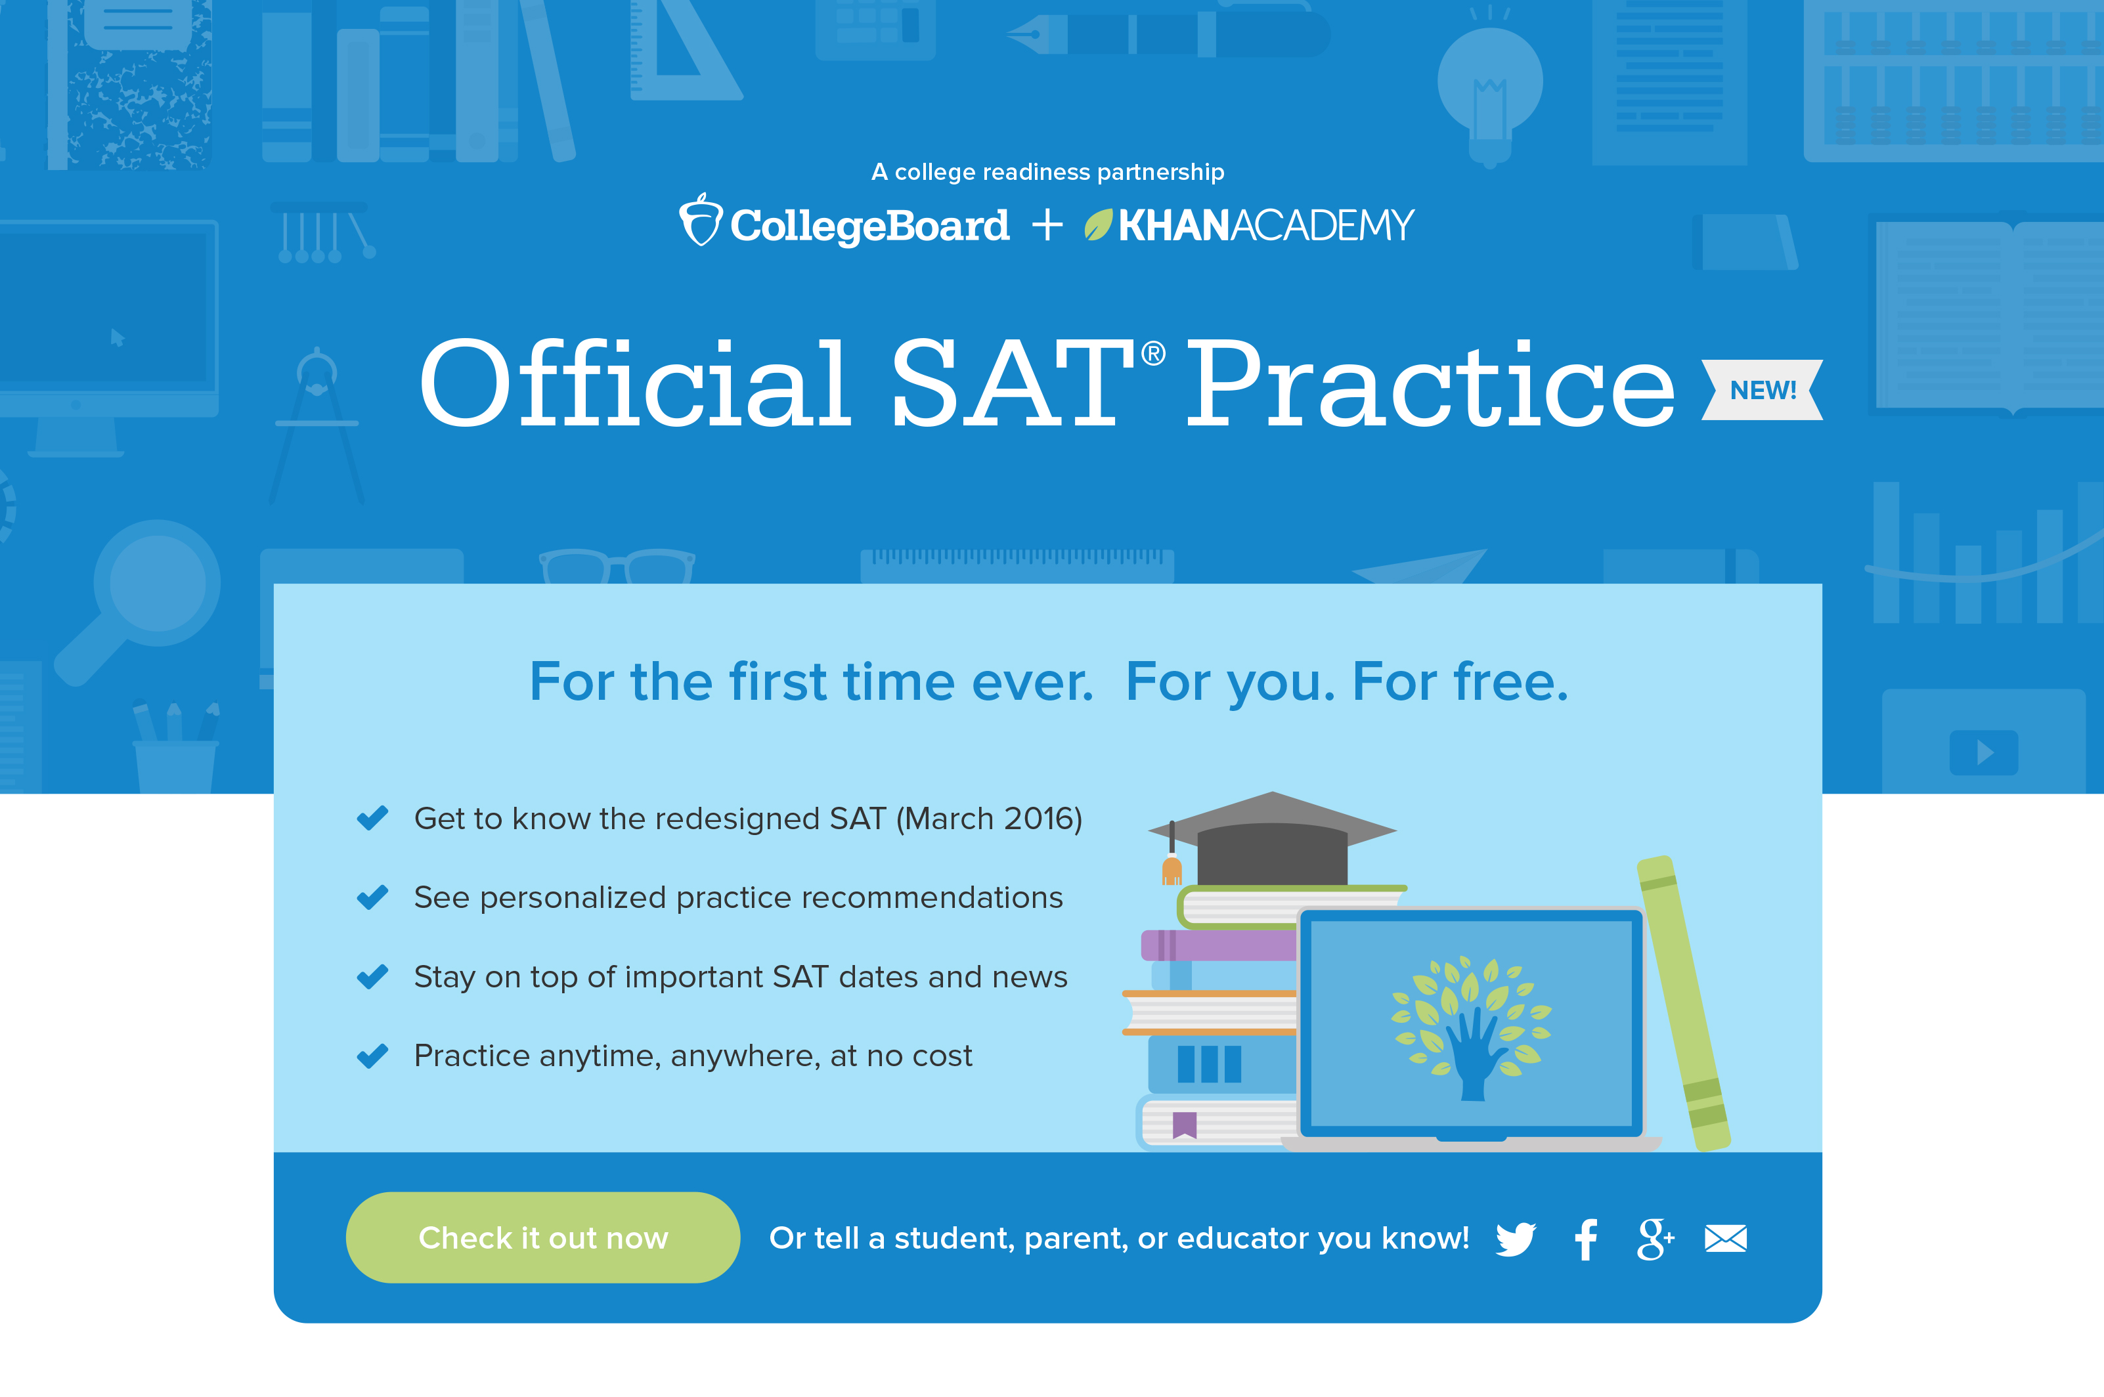
Steps to link your College Board and Khan Academy Accounts
Step 1
Log in to or create your
Khan Academy account at satpractice.org
Step 2
When prompted, agree to link
your Khan Academy and
College Board accounts
Step 3
Sign in or create your
College Board Account and hit “Send” to send your scores
Sign up. Link up. Get practicing.
Notes:
Alternate text for screen shot:
A screen shot is titled: Official SAT Practice NEW! A subhead reads For the first time ever. For you. For free. There are four bullet points: Get to know the redesigned SAT (March 2016); See personalized practice recommendations; Stay on top of important SAT dates and news; Practice anytime, anywhere, at no cost.

Slide 4
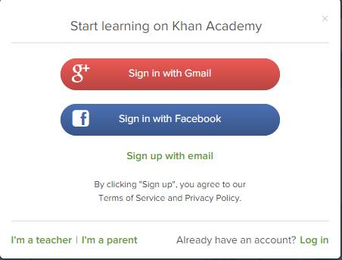
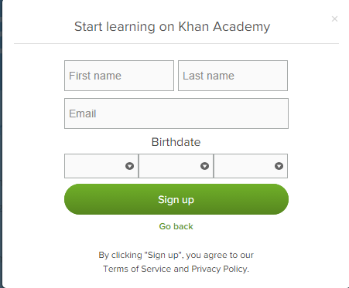
Step 1:
Create a Khan Academy Account
Log in to or create your Khan Academy account
  Go to satpractice.org
  Click green button labeled “Check it out now”
  Sign in with Gmail, Facebook,
  or click “Sign up with email”
    If you click Sign in with Gmail or Facebook,
    enter in your username and password for
    either these accounts and you are signed in
    If you click “Sign up with email” Enter in
    First Name/Last name/Email/Birthdate
    and click “Sign Up”
      An email will been sent to your account
      to verify; sign in to your email
      Open email from Khan Academy accounts
      and click on the “Finish Signing Up” button
      A welcome screen will appear where you will enter username and password and click “Sign Up”
Notes:
A screen shot shows that users may sign in with Gmail or Facebook. A fillable form is titled Start learning on Khan Academy. It requires users to enter first name, last name, email and a birthdate. When complete to click the green sign up button.

Slide 5
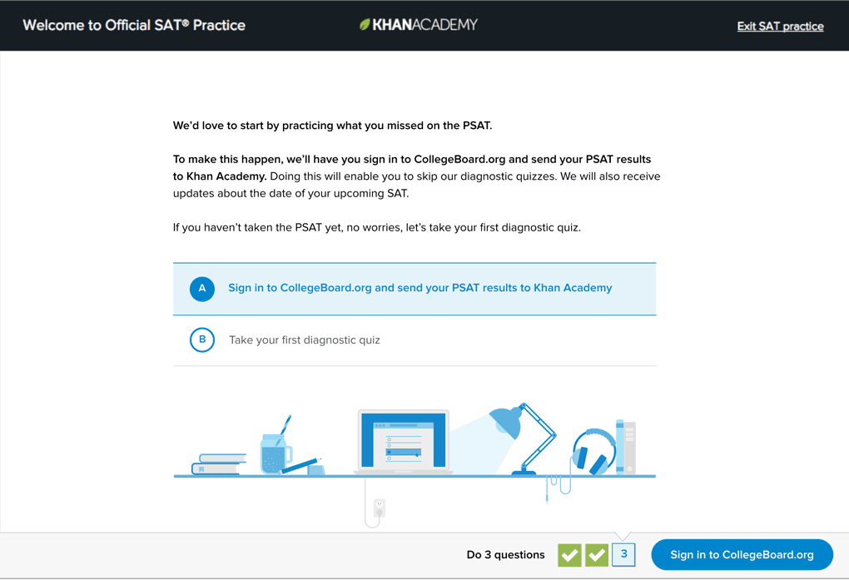
Step 2:
Begin to link your Khan Academy Account to College Board
You have logged into
Khan Academy for the first time and will be asked if you would like to send PSAT results
If you already have a Khan Academy account, a prompt will appear asking
if you want to send your PSAT results to Khan Academy
After choosing that option, you will be directed to collegeboard.org
Notes:
A screen grab is titled: Welcome to Official SAT Practice Khan Academy. Type reads: We’d love to start by practicing what you missed on the PSAT. To make this happen we’ll have you sign in to the CollegBoard.org and send your PSAT results to Khan Academy. Doing this will enable you to skip our diagnostic quizzes. We will also receive updates about the date of your upcoming SAT. If you haven’t taken the PSAT yet, no worries, let’s take your first diagnostic quiz. There are two options: A Sign in to CollegeBoard.org and send your PSAT results to Khan Academy or B Take your first diagnostic quiz.

Slide 6
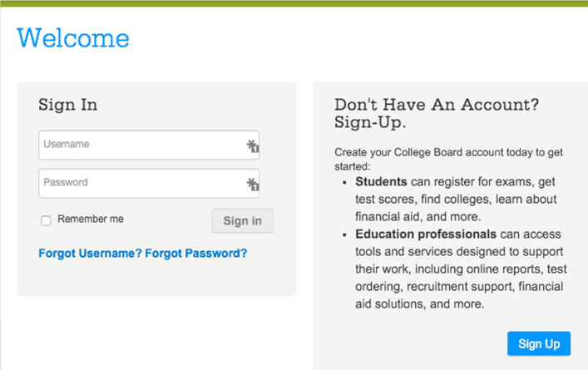
Step 3:
Create a College Board Account
Sign in to your College Board account; if you do not have a
College Board account, click
'Sign Up' to create one.
The steps for creating a
College Board account are:
  Click on the “Sign up” blue box
  Fill in the fields to create your
  student account ensuring all information is correct
  Click “Next” at the bottom
  when all fields are completed
  You are now Signed In
Please note that students under 13 cannot create a College Board Account.
Notes:
A screen shot shows to fillable boxes a user must fill in to create a College Board Account: username and password. A remember me box may be clicked. A side note advises Students can register for exams, get test scores, find colleges, learn about financial aid and more. Education professionals can access tools and services designed to support their work, including online reports, test ordering, recruitment support, financial aid solutions and more.

Slide 7
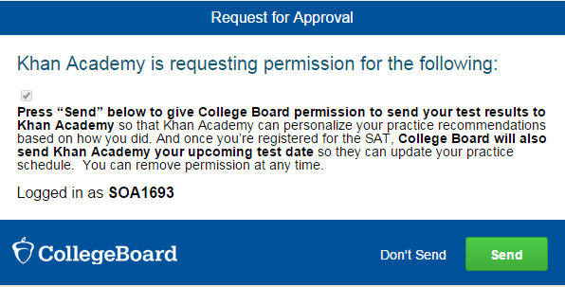
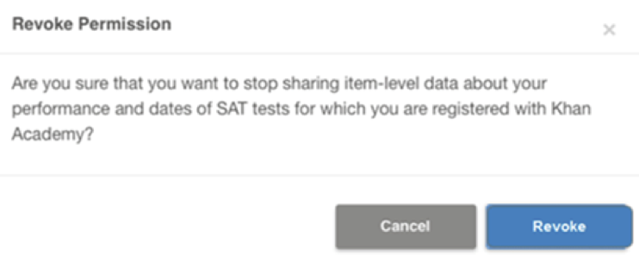
Step 3:
And Hit Send to Link Accounts
After successfully logging in to your College Board account,
you will be asked for permission to link your accounts.
After clicking “Send” you will
be redirected to SAT practice
on the Khan Academy site.
You can remove the link at
any time, by clicking on
“Revoke” which is found in College Board account settings.
Notes:
A screen shot is titled Request for Approval: Khan Academy is requesting permission for the following: Press send below to give College Board permission to send your test results to Khan Academy so that Khan Academy can personalize your practice recommendations based on how you did. And once you’re registered for the SAT College Board will also send Khan Academy your upcoming test dates so they can update your practice schedule. You can remove permission at any time. A green send button is highlighted. Below is a step titled Revoke Permission. Clicking on the blue button labeled Revoke will do so.

Slide 8
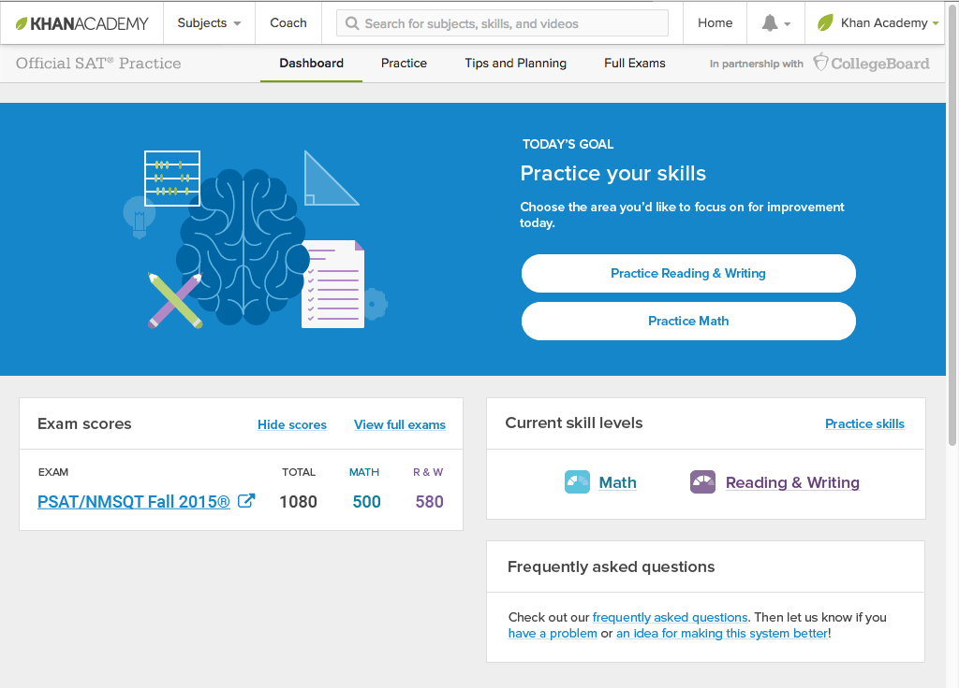
Now Start Practicing on Khan Academy with Personalized Recommendations
You can start your practice in either Math or Evidence Based Reading & Writing.
The recommendations
are based on how you did on the PSAT/NMSQT or PSAT 8/9.
Keep practicing –
with each additional problem and activity
the personalization gets stronger and gets you closer to your goal
score on the SAT,
PSAT/NMSQT, PSAT 10,
or PSAT 8/9.
Notes:
A screen grab is titled Today’s Goal: Practice your skills. Users may click on Reading & Writing or Practice Math to begin their practice. A sample combined score of 1080 is shown: 500 for math; 580 for reading and writing. A section called current skill levels is shown as is frequently asked questions.

